Slide 1
Wafermap Analysis Report
Generated on 2026-02-26 13:46

Slide 2
Gage R&R Report - Agenda
# | Group | Parameters | Pages | Slides
1 | 📋 Agenda | - | Page 2 | 1
2 | 📖 Calculation Parameters | - | Page 3 | 1
3 | Dc_Pwr | 10 | Page 4-8 | 5
4 | 📍 Stitched - Pixel Position based | 10 dies | Page 9-19 | 11
Total: 4 Groups | 10 Parameters | 18 Slides

Slide 3
Gage R&R - Calculation Parameters
BASIC STATISTICAL VALUES
Mean (Mittelwert):
Average of all measurements across all files and dies.
Mean = Σ(xi) / n
Std Dev (Standardabweichung):
Measure of dispersion around the mean.
σ = √[Σ(xi - Mean)² / n]
Range (Spannweite):
Difference between maximum and minimum.
Range = Max - Min
LSL / USL (Spec Limits):
Statistical limits (k = sigma factor).
LSL = Mean - kσ | USL = Mean + kσ
GAGE R&R COMPONENTS
Repeatability (EV):
Variation within measurements of one file (equipment).
EV = Mean(σ within each file)
Reproducibility (AV):
Variation between files/operators/trials.
AV = σ(file means)
GRR Total:
Combined measurement system variation.
GRR = R̄ / d₂ (Range Method)
ASSESSMENT METRICS
%GRR (Prozent GRR):
GRR as percentage of total variation or tolerance.
%GRR = (GRR / TV) × 100 or (GRR / Tolerance) × 100
ndc (Using Total Variation):
Number of distinct categories the system can distinguish.
ndc = 1.41 × (TV / GRR)
ASSESSMENT CRITERIA (AIAG MSA)
🟢 EXCELLENT: %GRR < 10%
Measurement system is acceptable.
🟡 ACCEPTABLE: 10% ≤ %GRR < 30%
May be acceptable depending on application.
🔴 UNACCEPTABLE: %GRR ≥ 30%
Measurement system must be improved.
ndc ≥ 5: Good measurement system
Can distinguish ≥ 5 distinct categories.
INTERPRETATION
• High Repeatability → Equipment/method problem
• High Reproducibility → Operator/process/time problem
• ndc should be ≥ 5 for a good measurement system
• Values outside LSL/USL indicate outliers

Slide 4
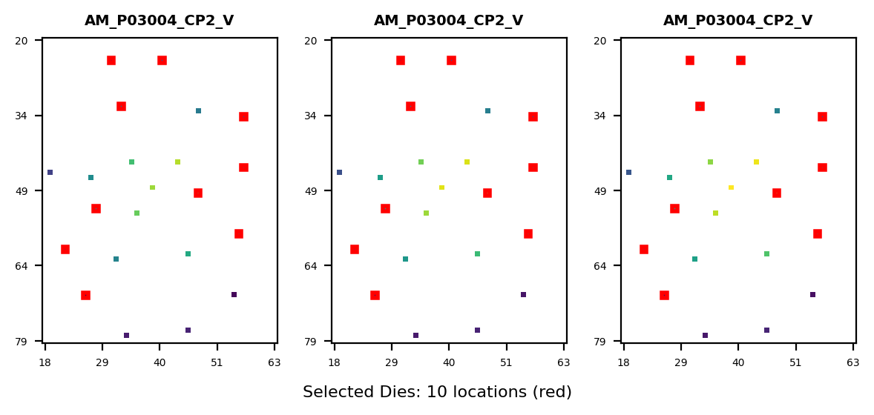
Gage R&R Study Overview - Dc_Pwr
Study Configuration
• Files/Trials: 3 • Dies/Parts: 10 • Parameters: 11
Parameters Analyzed:
1. 11405006: STATIC_VDD10_VNOM_X VDD10 22.g404hc
2. 11405007: STATIC_VDD18IO_VNOM_X VDD18IO 22.a4
3. 11405008: STATIC_AVDD18_VNOM_X AVDD18 22.c403
4. 11405009: STATIC_AVEE_VNOM_X AVEE 20.w402 <>
5. 11405010: STATIC_TotalPower_VNOM_X TotalPower
6. 11405011: STATIC_VDD10_VMIN_X VDD10 22.g404hc
7. 11405012: STATIC_VDD18IO_VMIN_X VDD18IO 22.a4
8. 11405013: STATIC_AVDD18_VMIN_X AVDD18 22.c403
... +2 more
Overall Result: FAIL
✗ Gage R&R FAILED for 6 parameter(s) due to excessive measurement variation (>30%). Failing parameters: DC_PWR_STATIC_AVEE_VMIN_X, DC_PWR_STATIC_AVEE_VNOM_X, DC_PWR_STATIC_AVDD18_VNOM (+3 more) Recommendation: Review measurement equipment, operator training, or test methodology.
Assessment: 0 Excellent | 4 Acceptable | 6 Unacceptable

Slide 5
Gage R&R - Calculation Parameters (Formulas)
BASIC STATISTICAL VALUES
Mean (Mittelwert):
Average of all measurements across all files and dies.
Mean = Σ(xi) / n
Std Dev (Standardabweichung):
Measure of dispersion around the mean.
σ = √[Σ(xi - Mean)² / n]
Range (Spannweite):
Difference between maximum and minimum.
Range = Max - Min
LSL / USL (Spec Limits):
Statistical limits (k = sigma factor).
LSL = Mean - kσ | USL = Mean + kσ
GAGE R&R COMPONENTS
Repeatability (EV):
Variation within measurements of one file (equipment).
EV = Mean(σ within each file)
Reproducibility (AV):
Variation between files/operators/trials.
AV = σ(file means)
GRR Total:
Combined measurement system variation.
GRR = R̄ / d₂ (Range Method)
Part Variation (PV):
True variation between parts/dies.
PV = σ(part means)
Total Variation (TV):
Total observed variation.
TV = √(PV² + GRR²)
ASSESSMENT METRICS
%GRR (Prozent GRR):
GRR as percentage of total variation or tolerance.
%GRR = (GRR / TV) × 100 or (GRR / Tolerance) × 100
ndc (Using Part Variation):
Number of distinct categories the system can distinguish.
ndc = 1.41 × (PV / GRR)
ASSESSMENT CRITERIA (AIAG MSA)
🟢 EXCELLENT: %GRR < 10%
Measurement system is acceptable.
🟡 ACCEPTABLE: 10% ≤ %GRR < 30%
May be acceptable depending on application.
🔴 UNACCEPTABLE: %GRR ≥ 30%
Measurement system must be improved.
ndc ≥ 5: Good measurement system
Can distinguish ≥ 5 distinct categories.
INTERPRETATION
• High Repeatability → Equipment/method problem
• High Reproducibility → Operator/process/time problem
• ndc should be ≥ 5 for a good measurement system
• Values outside LSL/USL indicate outliers

Slide 6
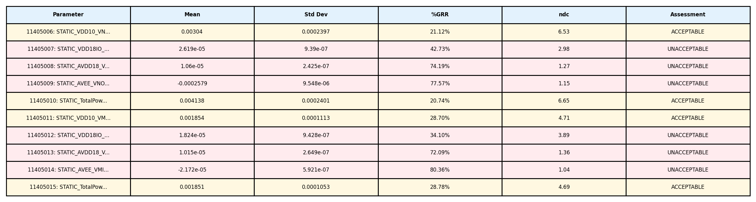
Gage R&R Analysis Summary - Dc_Pwr
Study Information: • Files (Operators/Trials): 3 • Dies (Parts): 10 • Parameters Analyzed: 11

Slide 7
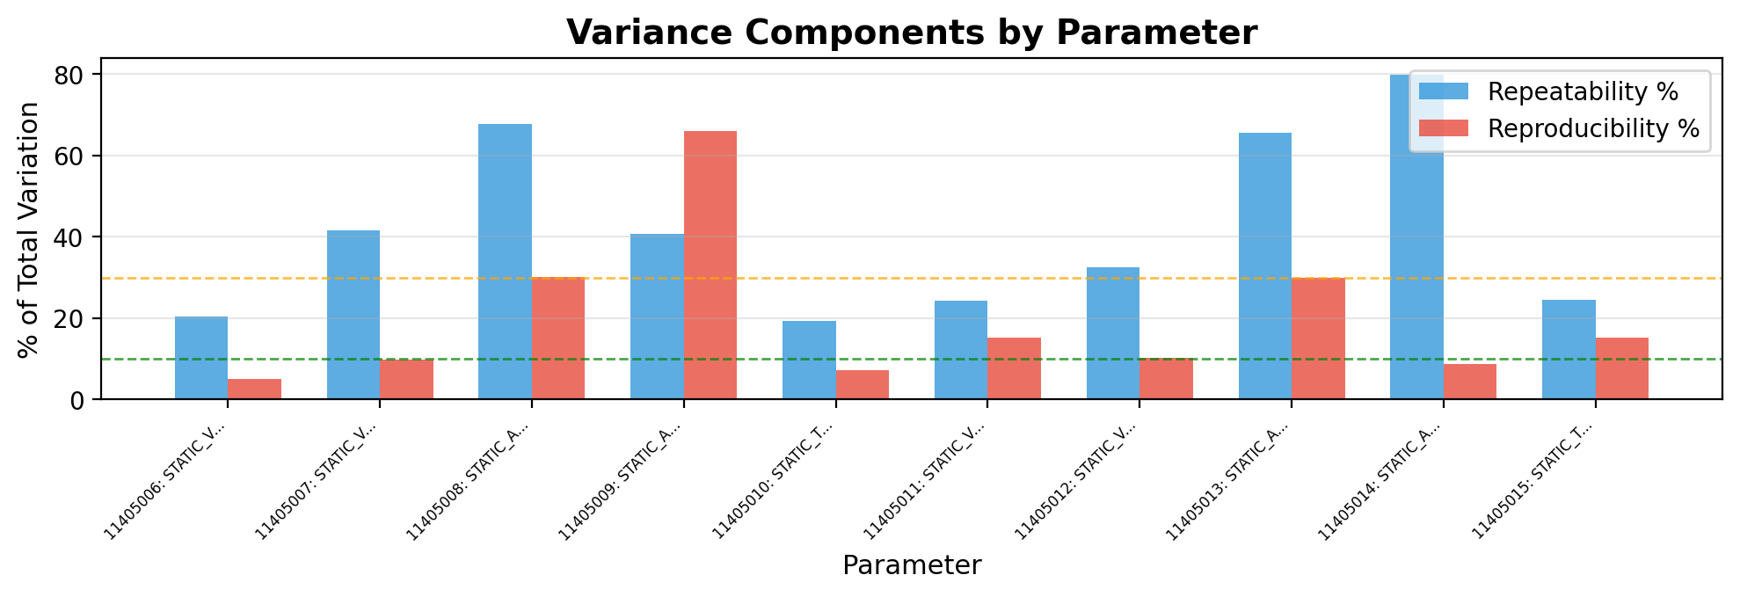
Gage R&R - Variance Components - Dc_Pwr
Interpretation:
• Repeatability (blue): Variation when same operator measures same part multiple times (equipment variation)
• Reproducibility (red): Variation between different operators/trials measuring same part (operator variation)
→ Analysis: Repeatability (41.7%) > Reproducibility (19.7%). Equipment/method variation is dominant. Consider equipment calibration or method refinement.

Slide 8
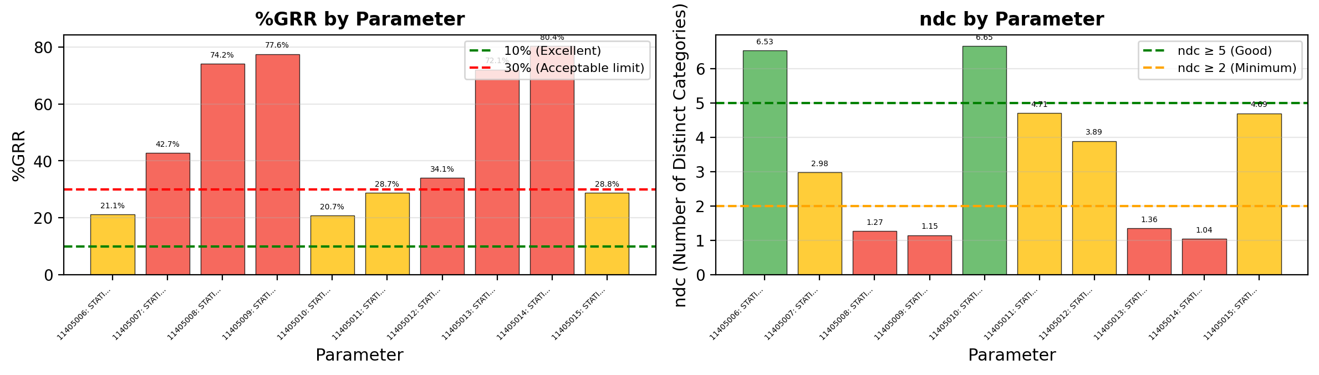
Gage R&R - %GRR and ndc - Dc_Pwr
Acceptance Criteria & Interpretation:
• %GRR < 10%: EXCELLENT - Measurement system is excellent for this application
• %GRR 10-30%: ACCEPTABLE - May be acceptable depending on application criticality
• %GRR > 30%: UNACCEPTABLE - Measurement system needs improvement
• ndc (Number of Distinct Categories): Indicates how many distinct categories the measurement can reliably distinguish. ndc ≥ 5 is recommended.
⚠ Warning: 8 parameter(s) have ndc < 5: DC_PWR_STATIC_VDD18I, DC_PWR_STATIC_AVDD18, DC_PWR_STATIC_AVEE_V

Slide 9
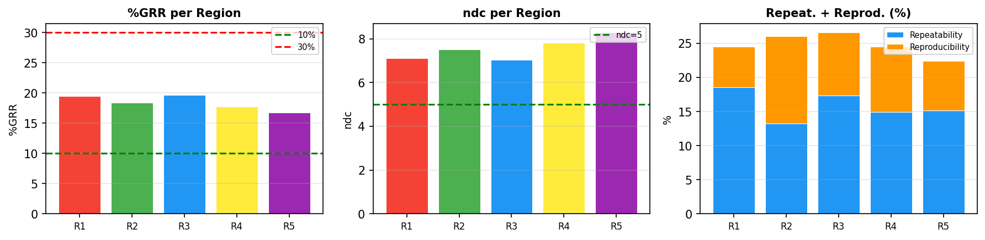
PLM Pixel Analysis - Stitched - Die (22,61)
Region | Position | Size | %GRR | ndc | Repeat.% | Reprod.% | Result
R1 | (141,158)->(166,183) | 25x25 | 19.5% | 7.1 | 18.5% | 6.0% | ACCEPTABLE
R2 | (329,286)->(354,311) | 25x25 | 18.4% | 7.5 | 13.2% | 12.9% | ACCEPTABLE
R3 | (212,400)->(237,425) | 25x25 | 19.6% | 7.0 | 17.4% | 9.2% | ACCEPTABLE
R4 | (342,502)->(367,527) | 25x25 | 17.7% | 7.8 | 14.9% | 9.6% | ACCEPTABLE
R5 | (460,484)->(485,509) | 25x25 | 16.8% | 8.3 | 15.1% | 7.3% | ACCEPTABLE
Die (22, 61)
PLM Type: Stitched
Regions: 5
Files/Trials: 3
Pixels/Region: 625
Best: R5 - %GRR=16.8%
Worst: R3 - %GRR=19.6%

Slide 10
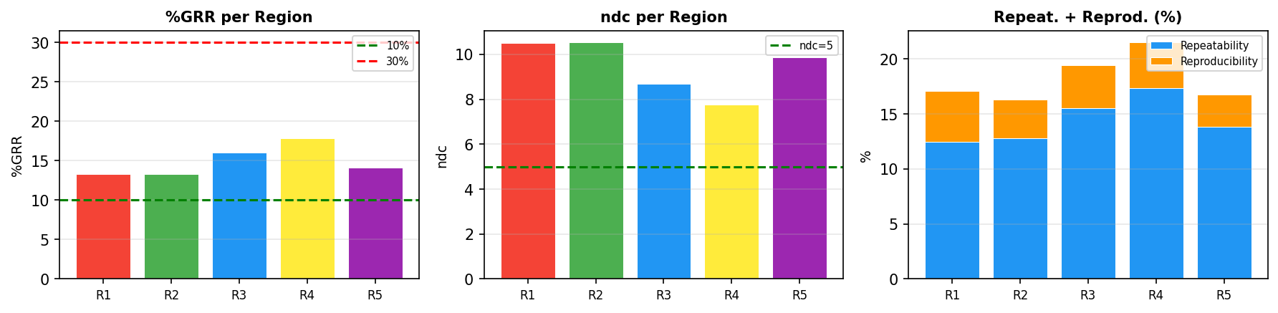
PLM Pixel Analysis - Stitched - Die (26,70)
Region | Position | Size | %GRR | ndc | Repeat.% | Reprod.% | Result
R1 | (141,158)->(166,183) | 25x25 | 13.3% | 10.5 | 12.5% | 4.6% | ACCEPTABLE
R2 | (329,286)->(354,311) | 25x25 | 13.3% | 10.5 | 12.8% | 3.5% | ACCEPTABLE
R3 | (212,400)->(237,425) | 25x25 | 16.0% | 8.7 | 15.5% | 3.9% | ACCEPTABLE
R4 | (342,502)->(367,527) | 25x25 | 17.8% | 7.8 | 17.4% | 4.1% | ACCEPTABLE
R5 | (460,484)->(485,509) | 25x25 | 14.1% | 9.9 | 13.8% | 3.0% | ACCEPTABLE
Die (26, 70)
PLM Type: Stitched
Regions: 5
Files/Trials: 3
Pixels/Region: 625
Best: R2 - %GRR=13.3%
Worst: R4 - %GRR=17.8%

Slide 11
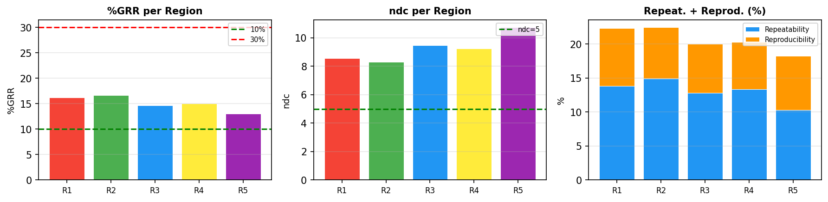
PLM Pixel Analysis - Stitched - Die (28,53)
Region | Position | Size | %GRR | ndc | Repeat.% | Reprod.% | Result
R1 | (141,158)->(166,183) | 25x25 | 16.2% | 8.6 | 13.8% | 8.5% | ACCEPTABLE
R2 | (329,286)->(354,311) | 25x25 | 16.7% | 8.3 | 14.9% | 7.5% | ACCEPTABLE
R3 | (212,400)->(237,425) | 25x25 | 14.7% | 9.5 | 12.8% | 7.2% | ACCEPTABLE
R4 | (342,502)->(367,527) | 25x25 | 15.1% | 9.2 | 13.4% | 6.9% | ACCEPTABLE
R5 | (460,484)->(485,509) | 25x25 | 13.0% | 10.7 | 10.3% | 8.0% | ACCEPTABLE
Die (28, 53)
PLM Type: Stitched
Regions: 5
Files/Trials: 3
Pixels/Region: 625
Best: R5 - %GRR=13.0%
Worst: R2 - %GRR=16.7%

Slide 12
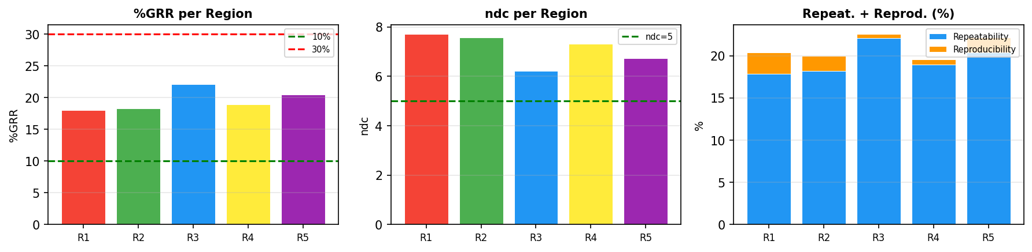
PLM Pixel Analysis - Stitched - Die (31,24)
Region | Position | Size | %GRR | ndc | Repeat.% | Reprod.% | Result
R1 | (141,158)->(166,183) | 25x25 | 18.0% | 7.7 | 17.8% | 2.5% | ACCEPTABLE
R2 | (329,286)->(354,311) | 25x25 | 18.3% | 7.6 | 18.2% | 1.8% | ACCEPTABLE
R3 | (212,400)->(237,425) | 25x25 | 22.1% | 6.2 | 22.1% | 0.4% | ACCEPTABLE
R4 | (342,502)->(367,527) | 25x25 | 19.0% | 7.3 | 18.9% | 0.6% | ACCEPTABLE
R5 | (460,484)->(485,509) | 25x25 | 20.5% | 6.7 | 20.4% | 1.7% | ACCEPTABLE
Die (31, 24)
PLM Type: Stitched
Regions: 5
Files/Trials: 3
Pixels/Region: 625
Best: R1 - %GRR=18.0%
Worst: R3 - %GRR=22.1%

Slide 13
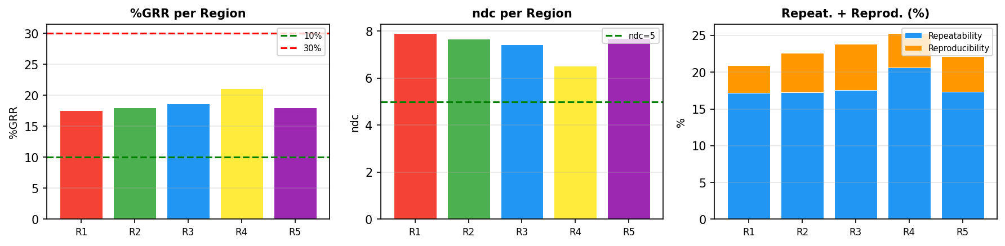
PLM Pixel Analysis - Stitched - Die (33,33)
Region | Position | Size | %GRR | ndc | Repeat.% | Reprod.% | Result
R1 | (141,158)->(166,183) | 25x25 | 17.6% | 7.9 | 17.2% | 3.8% | ACCEPTABLE
R2 | (329,286)->(354,311) | 25x25 | 18.1% | 7.7 | 17.3% | 5.3% | ACCEPTABLE
R3 | (212,400)->(237,425) | 25x25 | 18.6% | 7.4 | 17.6% | 6.3% | ACCEPTABLE
R4 | (342,502)->(367,527) | 25x25 | 21.1% | 6.5 | 20.6% | 4.6% | ACCEPTABLE
R5 | (460,484)->(485,509) | 25x25 | 18.0% | 7.7 | 17.3% | 4.9% | ACCEPTABLE
Die (33, 33)
PLM Type: Stitched
Regions: 5
Files/Trials: 3
Pixels/Region: 625
Best: R1 - %GRR=17.6%
Worst: R4 - %GRR=21.1%

Slide 14
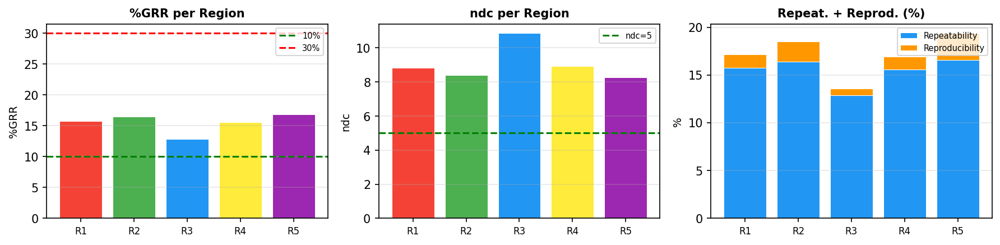
PLM Pixel Analysis - Stitched - Die (41,24)
Region | Position | Size | %GRR | ndc | Repeat.% | Reprod.% | Result
R1 | (141,158)->(166,183) | 25x25 | 15.8% | 8.8 | 15.7% | 1.4% | ACCEPTABLE
R2 | (329,286)->(354,311) | 25x25 | 16.5% | 8.4 | 16.4% | 2.1% | ACCEPTABLE
R3 | (212,400)->(237,425) | 25x25 | 12.9% | 10.9 | 12.9% | 0.7% | ACCEPTABLE
R4 | (342,502)->(367,527) | 25x25 | 15.6% | 8.9 | 15.5% | 1.4% | ACCEPTABLE
R5 | (460,484)->(485,509) | 25x25 | 16.8% | 8.3 | 16.6% | 2.8% | ACCEPTABLE
Die (41, 24)
PLM Type: Stitched
Regions: 5
Files/Trials: 3
Pixels/Region: 625
Best: R3 - %GRR=12.9%
Worst: R5 - %GRR=16.8%

Slide 15
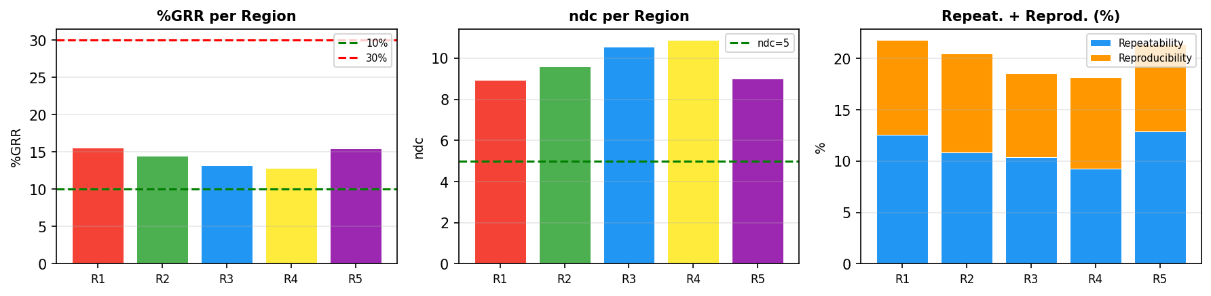
PLM Pixel Analysis - Stitched - Die (48,50)
Region | Position | Size | %GRR | ndc | Repeat.% | Reprod.% | Result
R1 | (141,158)->(166,183) | 25x25 | 15.6% | 8.9 | 12.6% | 9.2% | ACCEPTABLE
R2 | (329,286)->(354,311) | 25x25 | 14.5% | 9.6 | 10.8% | 9.7% | ACCEPTABLE
R3 | (212,400)->(237,425) | 25x25 | 13.2% | 10.6 | 10.4% | 8.2% | ACCEPTABLE
R4 | (342,502)->(367,527) | 25x25 | 12.9% | 10.9 | 9.2% | 9.0% | ACCEPTABLE
R5 | (460,484)->(485,509) | 25x25 | 15.5% | 9.0 | 12.9% | 8.5% | ACCEPTABLE
Die (48, 50)
PLM Type: Stitched
Regions: 5
Files/Trials: 3
Pixels/Region: 625
Best: R4 - %GRR=12.9%
Worst: R1 - %GRR=15.6%

Slide 16
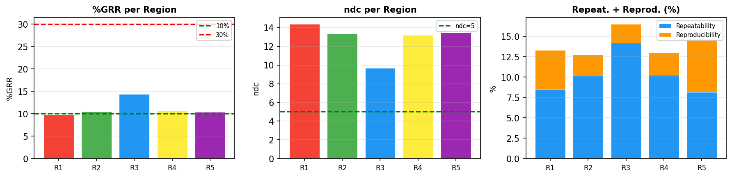
PLM Pixel Analysis - Stitched - Die (56,58)
Region | Position | Size | %GRR | ndc | Repeat.% | Reprod.% | Result
R1 | (141,158)->(166,183) | 25x25 | 9.8% | 14.4 | 8.5% | 4.9% | EXCELLENT
R2 | (329,286)->(354,311) | 25x25 | 10.5% | 13.3 | 10.2% | 2.6% | ACCEPTABLE
R3 | (212,400)->(237,425) | 25x25 | 14.4% | 9.7 | 14.2% | 2.3% | ACCEPTABLE
R4 | (342,502)->(367,527) | 25x25 | 10.6% | 13.2 | 10.3% | 2.7% | ACCEPTABLE
R5 | (460,484)->(485,509) | 25x25 | 10.4% | 13.4 | 8.2% | 6.5% | ACCEPTABLE
Die (56, 58)
PLM Type: Stitched
Regions: 5
Files/Trials: 3
Pixels/Region: 625
Best: R1 - %GRR=9.8%
Worst: R3 - %GRR=14.4%

Slide 17
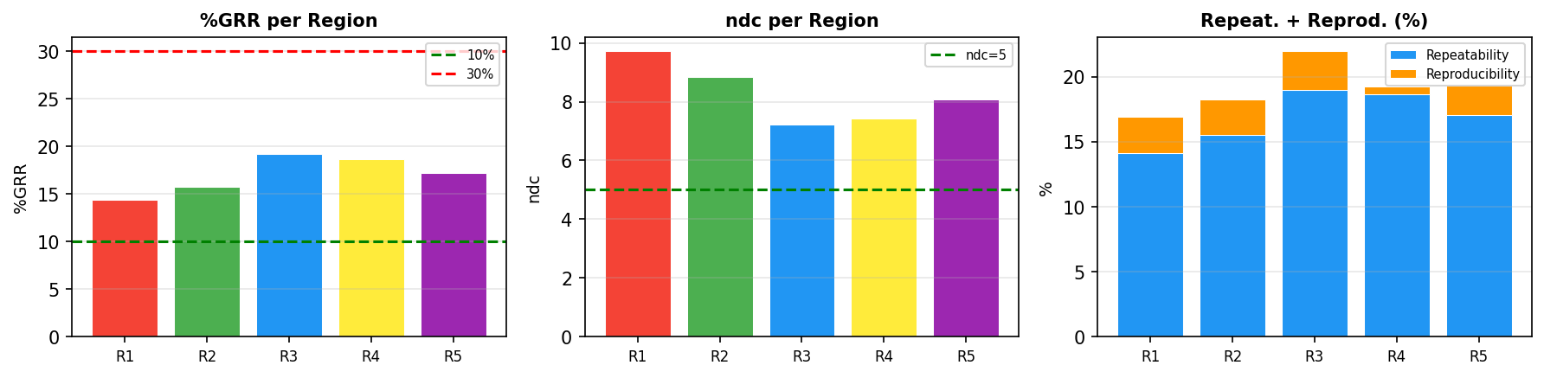
PLM Pixel Analysis - Stitched - Die (57,35)
Region | Position | Size | %GRR | ndc | Repeat.% | Reprod.% | Result
R1 | (141,158)->(166,183) | 25x25 | 14.4% | 9.7 | 14.1% | 2.8% | ACCEPTABLE
R2 | (329,286)->(354,311) | 25x25 | 15.8% | 8.8 | 15.5% | 2.7% | ACCEPTABLE
R3 | (212,400)->(237,425) | 25x25 | 19.2% | 7.2 | 19.0% | 3.0% | ACCEPTABLE
R4 | (342,502)->(367,527) | 25x25 | 18.7% | 7.4 | 18.7% | 0.6% | ACCEPTABLE
R5 | (460,484)->(485,509) | 25x25 | 17.2% | 8.1 | 17.1% | 2.3% | ACCEPTABLE
Die (57, 35)
PLM Type: Stitched
Regions: 5
Files/Trials: 3
Pixels/Region: 625
Best: R1 - %GRR=14.4%
Worst: R3 - %GRR=19.2%

Slide 18
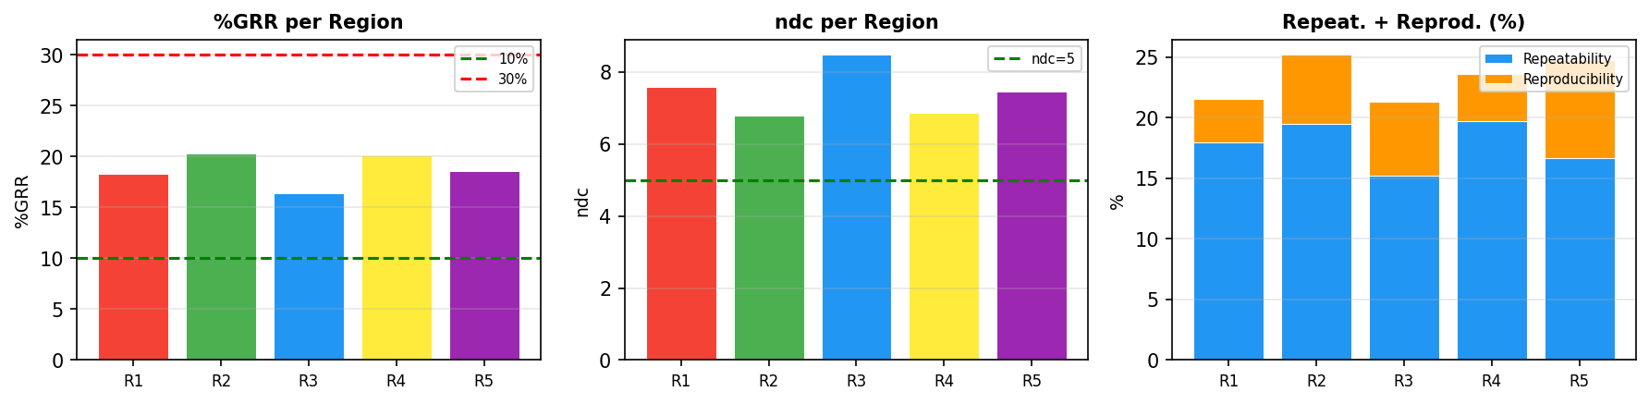
PLM Pixel Analysis - Stitched - Die (57,45)
Region | Position | Size | %GRR | ndc | Repeat.% | Reprod.% | Result
R1 | (141,158)->(166,183) | 25x25 | 18.3% | 7.6 | 17.9% | 3.6% | ACCEPTABLE
R2 | (329,286)->(354,311) | 25x25 | 20.3% | 6.8 | 19.5% | 5.7% | ACCEPTABLE
R3 | (212,400)->(237,425) | 25x25 | 16.4% | 8.5 | 15.2% | 6.1% | ACCEPTABLE
R4 | (342,502)->(367,527) | 25x25 | 20.1% | 6.9 | 19.7% | 3.9% | ACCEPTABLE
R5 | (460,484)->(485,509) | 25x25 | 18.6% | 7.5 | 16.7% | 8.1% | ACCEPTABLE
Die (57, 45)
PLM Type: Stitched
Regions: 5
Files/Trials: 3
Pixels/Region: 625
Best: R3 - %GRR=16.4%
Worst: R2 - %GRR=20.3%

Slide 19
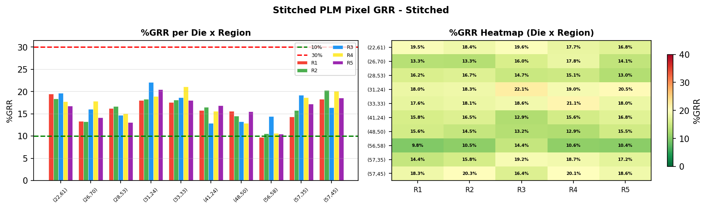
PLM Pixel Analysis - Stitched Overview - Stitched
Die | R1 %GRR | R2 %GRR | R3 %GRR | R4 %GRR | R5 %GRR | Avg %GRR
(22,61) | 19.5% | 18.4% | 19.6% | 17.7% | 16.8% | 18.4%
(26,70) | 13.3% | 13.3% | 16.0% | 17.8% | 14.1% | 14.9%
(28,53) | 16.2% | 16.7% | 14.7% | 15.1% | 13.0% | 15.2%
(31,24) | 18.0% | 18.3% | 22.1% | 19.0% | 20.5% | 19.6%
(33,33) | 17.6% | 18.1% | 18.6% | 21.1% | 18.0% | 18.7%
(41,24) | 15.8% | 16.5% | 12.9% | 15.6% | 16.8% | 15.5%
(48,50) | 15.6% | 14.5% | 13.2% | 12.9% | 15.5% | 14.3%
(56,58) | 9.8% | 10.5% | 14.4% | 10.6% | 10.4% | 11.1%
(57,35) | 14.4% | 15.8% | 19.2% | 18.7% | 17.2% | 17.0%
(57,45) | 18.3% | 20.3% | 16.4% | 20.1% | 18.6% | 18.7%
Stitched Die Comparison
PLM Type: Stitched
Total Dies: 10
Regions per Die: 5
Files/Trials: 3
Best: Die(56,58) R1 - 9.8%
Worst: Die(31,24) R3 - 22.1%

